Slide 1



IBM Storage
Trade-In Program
We pay our customers
real cash for
old IBM and Competitive machines
plus…
Dell EMC 2X Trade In Value
through December 31, 2021
IBM pays for
the pickup…
TS1140 EOS 2X Trade In Value
through March 31, 2022
Storage Trade-in website PartnerWorld or Seismic
Visit the Trade In BOX for Program Operations Guide, Eligible Product Lists, Calculator, Claim Form
…and disposal
of the
machines!
Contact: Katie Miles kmmiles@us.ibm.com

Slide 2
TS1140 End of Service 2X Trade In Value
TS1140 End of Service effective February 28, 2022
Replace TS1140 and earn $750 $1,500 Trade In Value through the end of 1Q 2022
IBM Trade In Payment is determined by:
  Trade In Replacement Allowance of the new solution sold (ex: TS1150) based on the type and quantity of Tape purchased. This Allowance is the max Trade In payment.
      ** Compared to **
  Trade In Replaced Value is based on the type and quantity of TS1140 tape drives being returned to IBM. TS1140 Trade In Value is DOUBLED for sales through March 31, 2022
  Trade In Payment is the TS1140 EOS 2X Trade In Value, not to exceed the Trade in Allowance.
ACT NOW!
Calculate Trade In Payment using Calculator and Eligible Product List
TS1140 Trade In Value available on End User Invoice/Lease Start November 15, 2021 – March 31, 2022
Immediately After the Sale or within 90 days: BP Submit Trade In Claim to aminsk@sk.ibm.com
9 months from Invoice/Lease Start Date: Initiate return of replaced machines
30 days after returned machines are validated, IBM sends payment to Customer
Contact: Katie Miles kmmiles@us.ibm.com

Slide 3
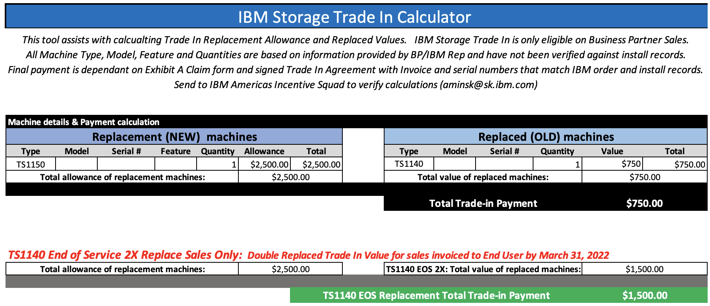
TS1140 EOS 2X Trade In

Slide 4
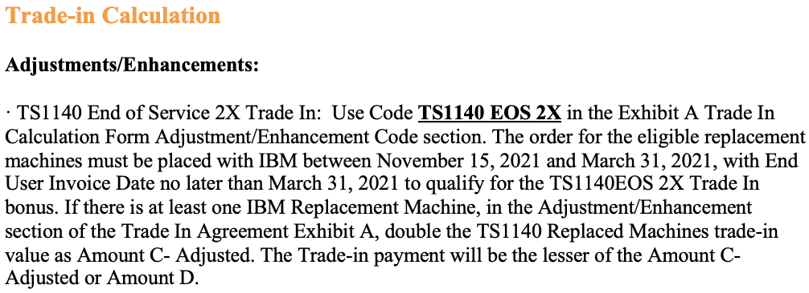
IBM Storage Trade In Operations Guide: How to Calculate TS1140 EOS 2X

Slide 5
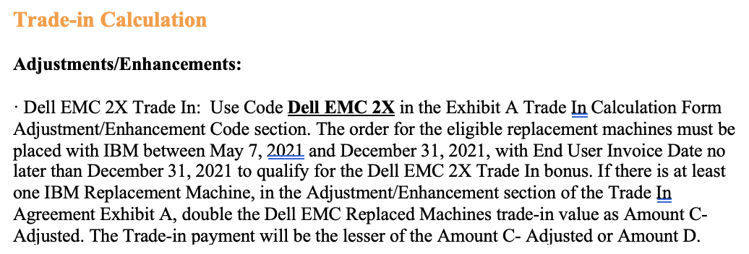
IBM Storage Trade In Operations Guide: How to Calculate Dell EMC 2X

